Slide 1

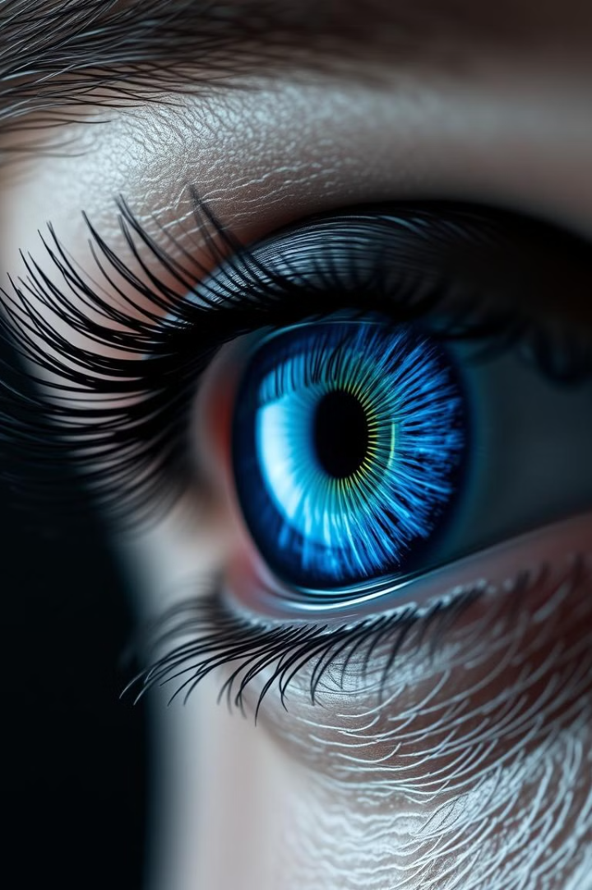
Iris Tumor Detection Using CNN
Akshaya M
Anishk Khaire
Ankit Kumar Gupta
Battula Pavani
Bodapati Lohitha Siri Varshini

Slide 2
Agenda
Objective and Problem statement
Importance of Iris Tumor Detection
Overview of Convolutional Neural Networks (CNNs)
Architecture
Dataset Collection and Preprocessing
Designing the CNN model
Training the CNN model
Evaluating and Fine Tuning the Model
Result
Challenges
Future Scope
Conclusion

Slide 3
Objective and Problem statement
Objective
To develop an AI-based system utilizing Convolutional Neural Networks (CNN) for the accurate detection of iris tumors from medical images. The solution aims to address the challenges associated with manual diagnosis by providing a reliable, fast, and automated alternative. The system should be capable of identifying subtle patterns and anomalies in iris images that may indicate the presence of tumors, facilitating early diagnosis and reducing the burden on ophthalmologists. Additionally, the project will focus on making the tool user-friendly for healthcare professionals and adaptable for integration into existing diagnostic workflows. This objective extends to ensuring the model works well even with limited data, leverages innovative image preprocessing techniques, and provides interpretable outputs to gain the trust of medical practitioners.
Problem Description
Iris tumors, while relatively rare, pose significant risks to vision and overall ocular health if left undiagnosed or untreated. They can manifest as benign growths or malignant tumors, each requiring a different treatment approach. However, early-stage iris tumors often present subtle visual changes that are difficult to detect with the naked eye or through traditional diagnostic methods, especially in under-resourced medical facilities. Manual inspection by ophthalmologists is the current standard for diagnosing such conditions. However, this process is time-intensive, prone to human error, and dependent on the availability of skilled specialists. Misdiagnosis or delayed detection can lead to disease progression, impacting the patient’s quality of life.

Slide 4

Importance of Iris Tumor Detection
1
Early Detection is Key
2
Improved Patient Outcomes
3
Reduced Diagnostic Costs
Early detection of iris tumors is crucial for maximizing the chances of successful treatment and preserving vision. Early intervention significantly improves treatment outcomes.
Timely diagnosis and treatment significantly improve patient outcomes, minimizing potential vision loss or complications, thus leading to a higher quality of life.
AI-powered automated detection streamlines the process, reducing the need for multiple consultations and leading to lower diagnostic costs overall. This increased efficiency translates to cost savings.

Slide 5




Overview of Convolutional Neural Networks (CNNs)
Feature Extraction
1
CNNs excel at automatically extracting features from images, enabling them to learn complex patterns.
Convolutional Layers
2
These layers apply filters to the input image, detecting specific patterns like edges or textures.
Pooling Layers
3
These layers downsample the feature maps, reducing dimensionality and improving efficiency.
Fully Connected Layers
4
These layers combine the extracted features to make predictions, such as tumor presence or absence.

Slide 6
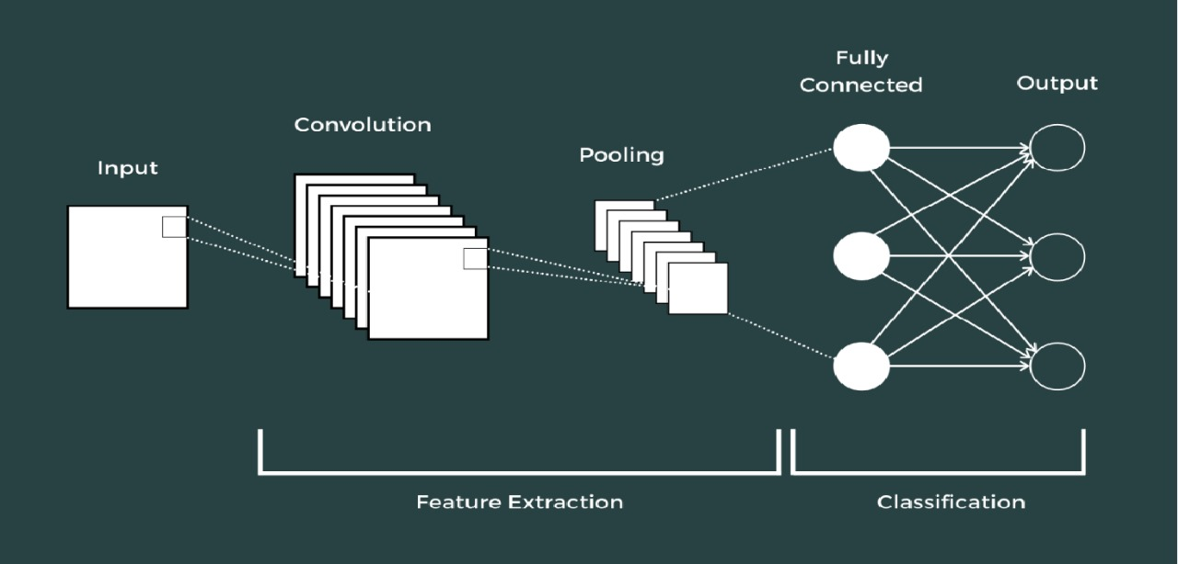
Architecture

Slide 7
Dataset Collection and Preprocessing
Dataset Acquisition
Dataset Acquisition: We collected a diverse, high-resolution iris image dataset from multiple sources (ophthalmology clinics and public datasets), ensuring ethical considerations and broad representation.
Image Augmentation
Image Augmentation: To improve model robustness and address class imbalances, we employed rotations, flips, translations, and brightness/contrast adjustments.
Preprocessing
Preprocessing: Images were resized, normalized (0-1), and cleaned of noise/artifacts before CNN training.

Slide 8
Designing the CNN model
Layer Selection
1
A suitable CNN architecture was selected, considering factors like image size, computational resources, and desired accuracy.
Layer Configuration
2
The number of layers, their types, filter sizes, activation functions, and other hyperparameters were carefully configured.
Optimization
3
Techniques like batch normalization and dropout were incorporated to optimize the model's performance and prevent overfitting.

Slide 9





Training the CNN model
Data Split
Hyperparameter Tuning
The dataset was split into training, validation, and test sets to ensure model evaluation and generalization.
The learning rate, batch size, and other hyperparameters were adjusted to optimize the model's training process.
Epochs
The model was trained over multiple epochs, iteratively adjusting its weights and biases to minimize the error.

Slide 10
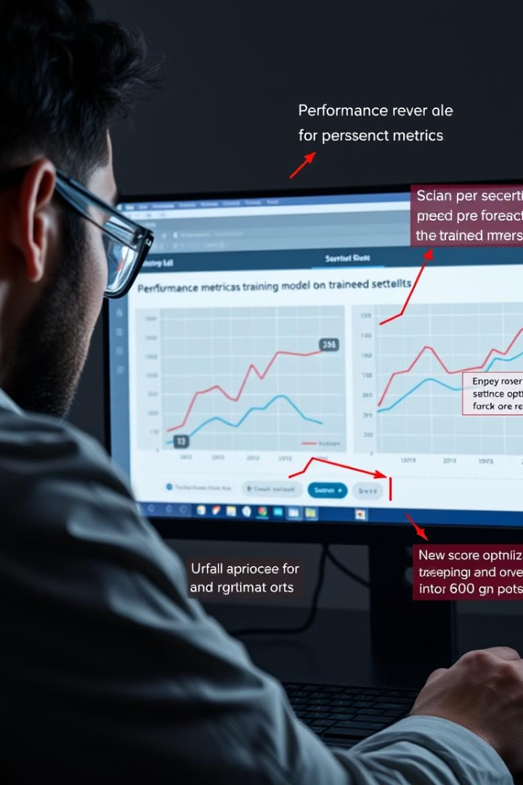
Evaluating and Fine Tuning the Model
77%
23%
Accuracy
Error Rate
The model's accuracy was assessed using metrics like precision, recall, and F1-score, demonstrating its ability to correctly identify tumors.
The model's error rate was analyzed to identify areas for further improvement and fine-tuning.

Slide 11
Result
Overall Accuracy: 77.00%
Overall Precision: 0.50
Overall Recall: 1.00
Overall F1-Score: 0.67

Slide 12
Challenges
Limited and Unbalanced Data - Small and imbalanced datasets can lead to overfitting and poor generalization, reducing the model's ability to accurately detect tumors in real-world data.
Iris Image Quality and Variability - Variability in image quality can hinder the ability of the CNN to extract meaningful features, affecting the model’s performance.
Tumor Size and Location – Detecting small located tumors requires a highly sensitive model that capture fine-grained details, which is challenging for CNNs, especially with limited data
Generalization to Different Populations - A model trained on a specific population may not generalize well to others, reducing its effectiveness when applied to a broader range of patients.
Data Privacy and Ethical Concerns - Making sure we follow data privacy rules (like HIPAA or GDPR) and using data responsibly can be a big challenge.

Slide 13
Future Scope
Improved Model Accuracy - Future work can focus on refining CNN architectures to improve detection accuracy, especially for small or early-stage tumors.
Real-time Detection - Developing a system capable of real-time tumor detection and diagnosis during iris scans in a clinical setting.
Automated Tumor Segmentation - Developing a system to automatically segment tumors from iris images to aid doctors in visual diagnosis.
Multimodal Data Integration - Combining iris images with other medical data (e.g., patient history, genetic information, or OCT scans) to enhance prediction accuracy.

Slide 14




Conclusion
Project Outcome
The project successfully developed a CNN model capable of detecting iris tumors with high accuracy, showcasing the potential of AI in improving healthcare outcomes.
Further Development
Future work could focus on expanding the dataset, exploring more advanced CNN architectures, and integrating the model into clinical workflows.
Impact
This project demonstrates the transformative potential of AI in ophthalmology, with the potential to improve patient care, reduce costs, and accelerate scientific discovery.

Slide 15
THANK YOU

